Slide 1
Predicting donation likelihood for a charity organisation
Stuti Nayak

Slide 2
Background
The dataset is provided by the Paralyzed Veterans of America (PVA).
PVA - 3.5 million donors (June 1997)
They focused their mailing list to the “lapsed” donor
PVA found an inverse correlation between likelihood to respond and the dollar amount of the gift

Slide 3
Objective: Maximise the amount of money that would be collected through a direct mail activity where letters would be posted to people in order to collect their donations.

Slide 4
The Dataset
The analysis data set includes:
A subset of the 3.5 million donors sent this appeal
A flag to indicate respondents to the appeal and the dollar amount of their donation
PVA promotion and giving history
Overlay demographics, including a mix of household and area level data.
Train set (from cup98LRN.txt): 95412 rows, 481 columns
Validation set (from cup98VAL.txt): 96367 rows, 479 columns
Targets: (i) TARGET_B: Target Variable: Binary Indicator for Response to the 97NK Mailing; (ii) Column TARGET_D: Target Variable: Donation Amount (in $) associated with the Response to 97NK Mailing

Slide 5
Challenges
Imbalanced data
Missing data
Long preprocessing of data

Slide 6
Data Ingestion and Imputation
For consistency of data types: create a dtype map from the data types provided.
Impute missing and NaN data:
for items related to promotion history (given amounts and promotion dates) impute 0's if missing [this is important because historical data may indicate future donations and imputing median will be incorrect]
for categorical data (object or ints), use the most frequent value (mode)
for continuous values (floats), use the median

Slide 7
Data Cleaning and Preprocessing
Manual preprocessing of data by looking at the data descriptions
For categorical features: one-hot encoding is introduced - this increases the dimensionality which is handled later
For the category ZIP code the dimensionality is high (5 digits) - this is reduced to 2 digits.
Convert alphabetical flags to 0 and 1
Transform date [YYMM] to month difference
Break down some features into multiple ones
Notes:
dropping features which do not have strong discriminative power
convert date to month difference [in order to reduce dimensionality]
breaking down 'DOMAIN' into two separate features
distributing the frequency and amount of features according to their respective range of values

Slide 8
Feature Selection
Handling Sparsity - remove all binary features (0/1) that are > 99.9% sparse in both the positive-set (people who donated) and negative-set (people who didn't).
Univariate feature analysis: apply t-test on each feature and compare p-value
for continuous features like age do a t-test
for categorical/binary features a permutation-test or chi-squared test is more appropriate (test for differences in average counts within two groups)
Fit a Random Forest regression-tree with default settings using the full feature-set and select the top-350 features based on variable importance.

Slide 9
Feature Engineering
Distribution of some features might be long-tailed - apply log transformation.
to model a nice linear functional relationship Y | X, it is nice to have Y normally distributed.
Otherwise, linear regression may seem to fit a linear function with high R-squared but in reality either
there is no linear relationship
the model fit is suboptimal due to presence of outliers (long-tailed distribution)¹
¹ https://en.wikipedia.org/wiki/Correlation_and_dependence#/media/File:Anscombe%27s_quartet_3.svg

Slide 10
Modeling Conventions
Train - Test split: 70 - 30%. Also transformed all the features in training data within (0,1) range using MinMaxScaler() from sklearn.
Binary: Build a balanced training-data by undersampling the negative examples.
Regression: We slice the training data and work only with data with positive donation amounts as the scoring metric for models is R-squared.
Hyperparameter tuning: Bayesian optimization is used to select the best parameters.
Evaluation metrics: (i) AUC, Precision-Recall (classification); (ii) R-squared (regression); (iii) Revenue evaluation metric for business model.

Slide 11
Model Selection: Binary Classification
The following classifiers have been implemented with their respective hyper-parameter optimization:
Random Forest Classifier: best_rfc()
K-Neighbours Classifier: best_knc()
Extreme Gradient Boosting Classifier: best_xgbc()
SVM Classifier: best_svc()
Extreme Tree Classifier: best_etc()

Slide 12
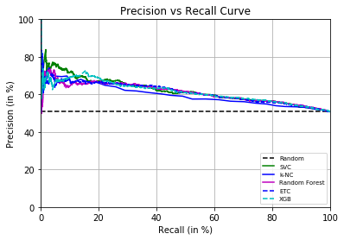
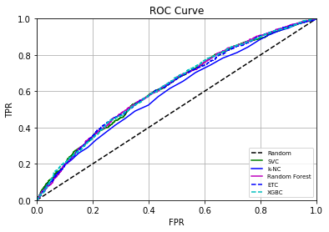
Model Selection: Classification

Slide 13
Model Selection: Regression
The following regression techniques have been implemented with their respective hyper-parameter optimization:
Lasso Regression: lasso_regression()
Ridge Regression: ridge_regression()
Random Forest Regressor: best_rfr()
Extreme Tree Classifier: best_etr()

Slide 14
Full Model for business model
Full Model = XGBoostClassifer[Predict Donor or Not]
+
RandomForestRegressor[Predict Amount]

Slide 15
Evaluation metric for business model
score all members in set using the model and pick ones scoring above a threshold for sending marketing materials
compute 'direct profit' resulting from selection all above a threshold using the predictions of trained-model on the test-set
Suppose S is a set of members who donated beyond a threshold value, then the profit can be calculated by:

Slide 16
Results
$24904.33 total amount donated from the validation data
16115 members donated! If mail cost was $1. --> Profit = $8789.33
If $5, then no profit at all; because according to the full model predictions no member pays above 2-3 dollars.

Slide 17
Summary
 | SVM | Extreme Tree Classifier | Extreme Gradient Boosting Classifier
Accuracy | 0.590 | 0.593 | 0.588
AUC Score | 0.620 | 0.625 | 0.622

Slide 18
Conclusion
In general tree based algorithms perform well in the data:
Xgboost is quick and has relatively good performance as the best performing classifier.
Random Forest regressor by far beats L1/L2 based regression models.
Learning and Making Decisions When Costs and Probabilities are Both Unknown (2001) by B. Zadrozny and C. Elkan provides good insights in solving the Regression problem. It might be interesting to incorporate the insights of this article.

